Slide 1
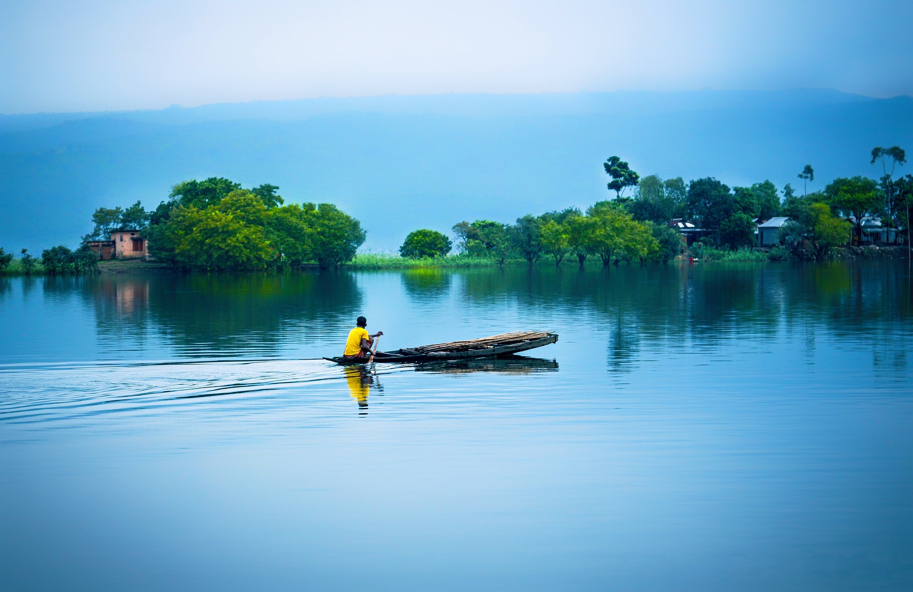
Welcome to Beautiful Bangladesh!
Presented by-
Md Miraj
Roll: 01-058-04
Batch-56

Slide 2
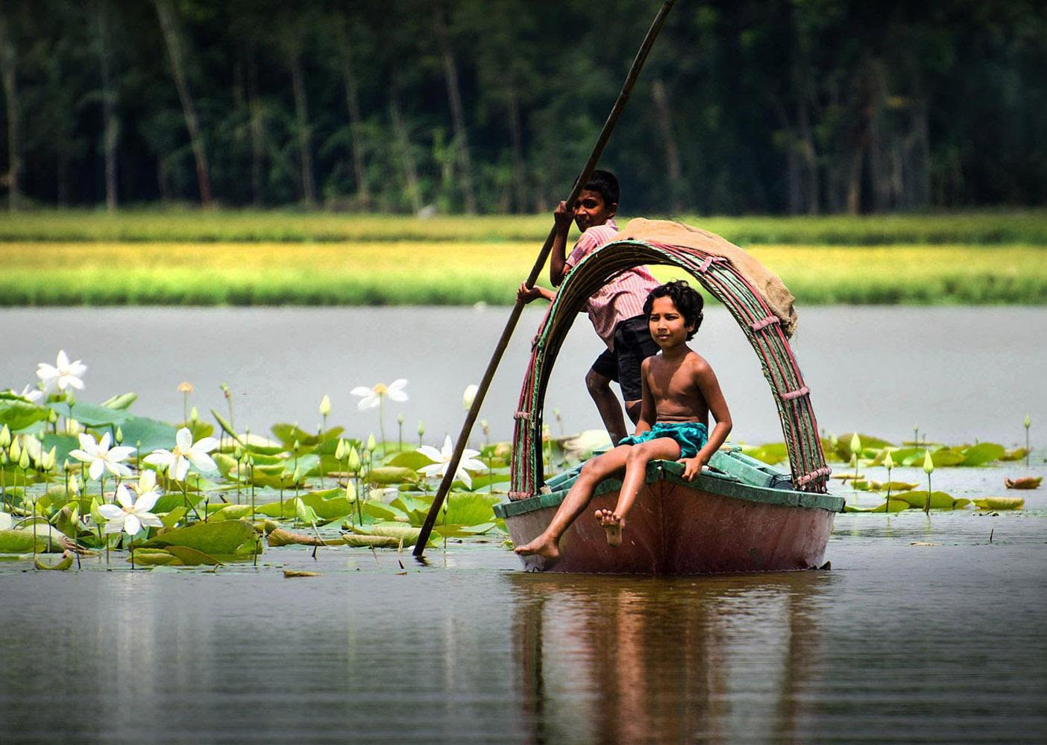
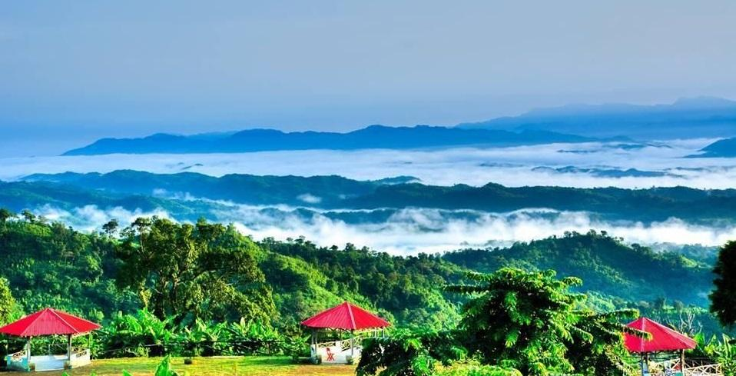
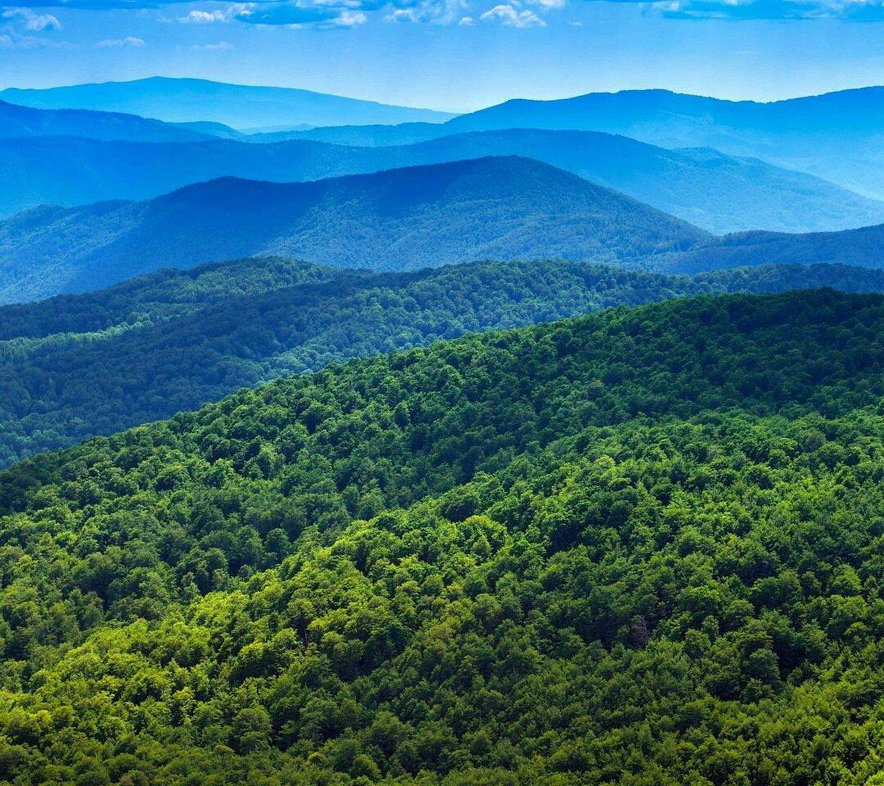
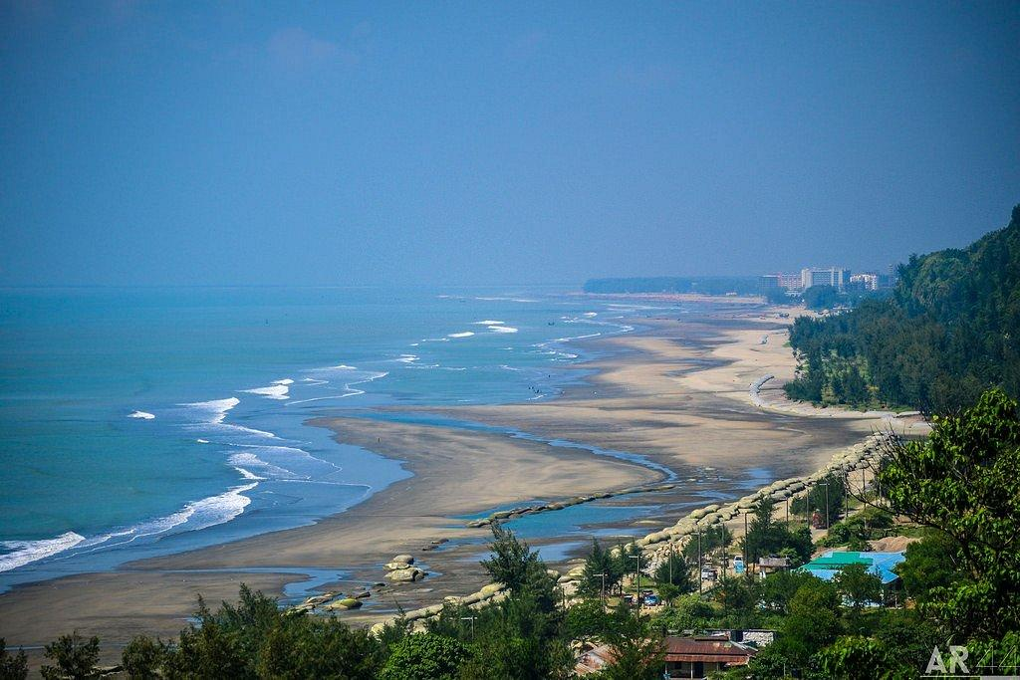
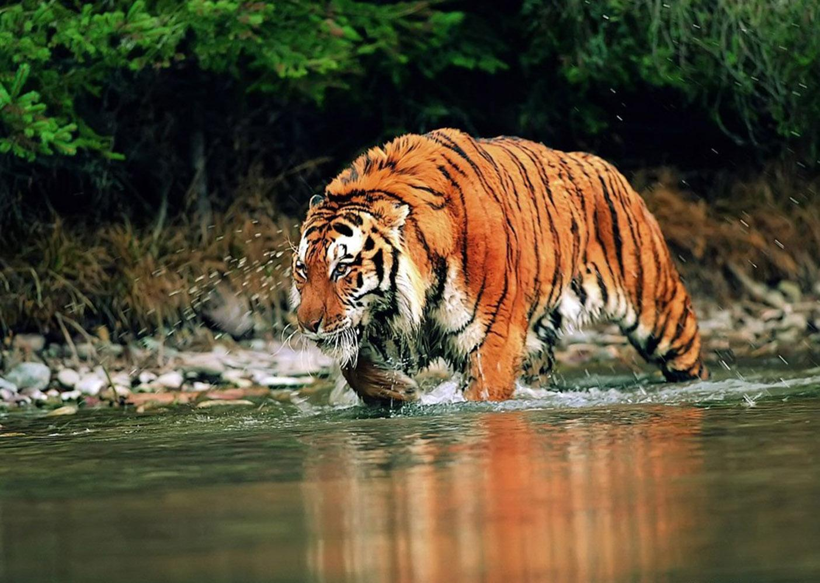
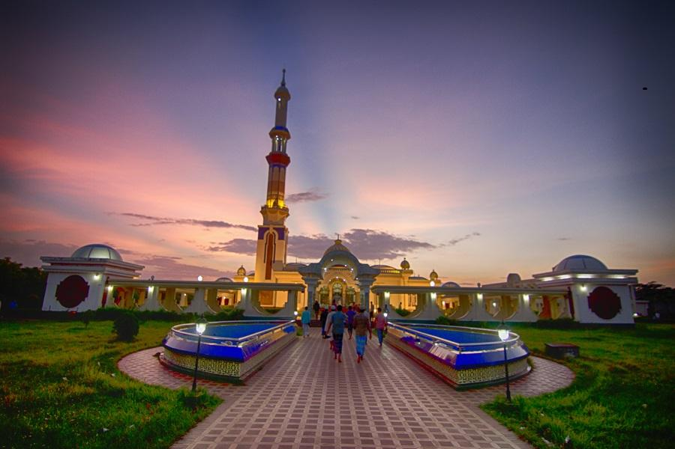
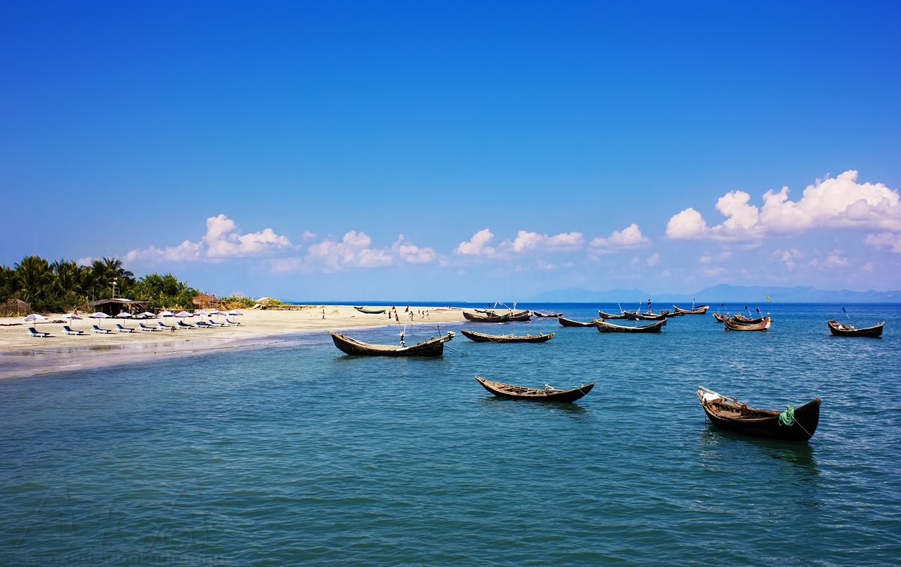
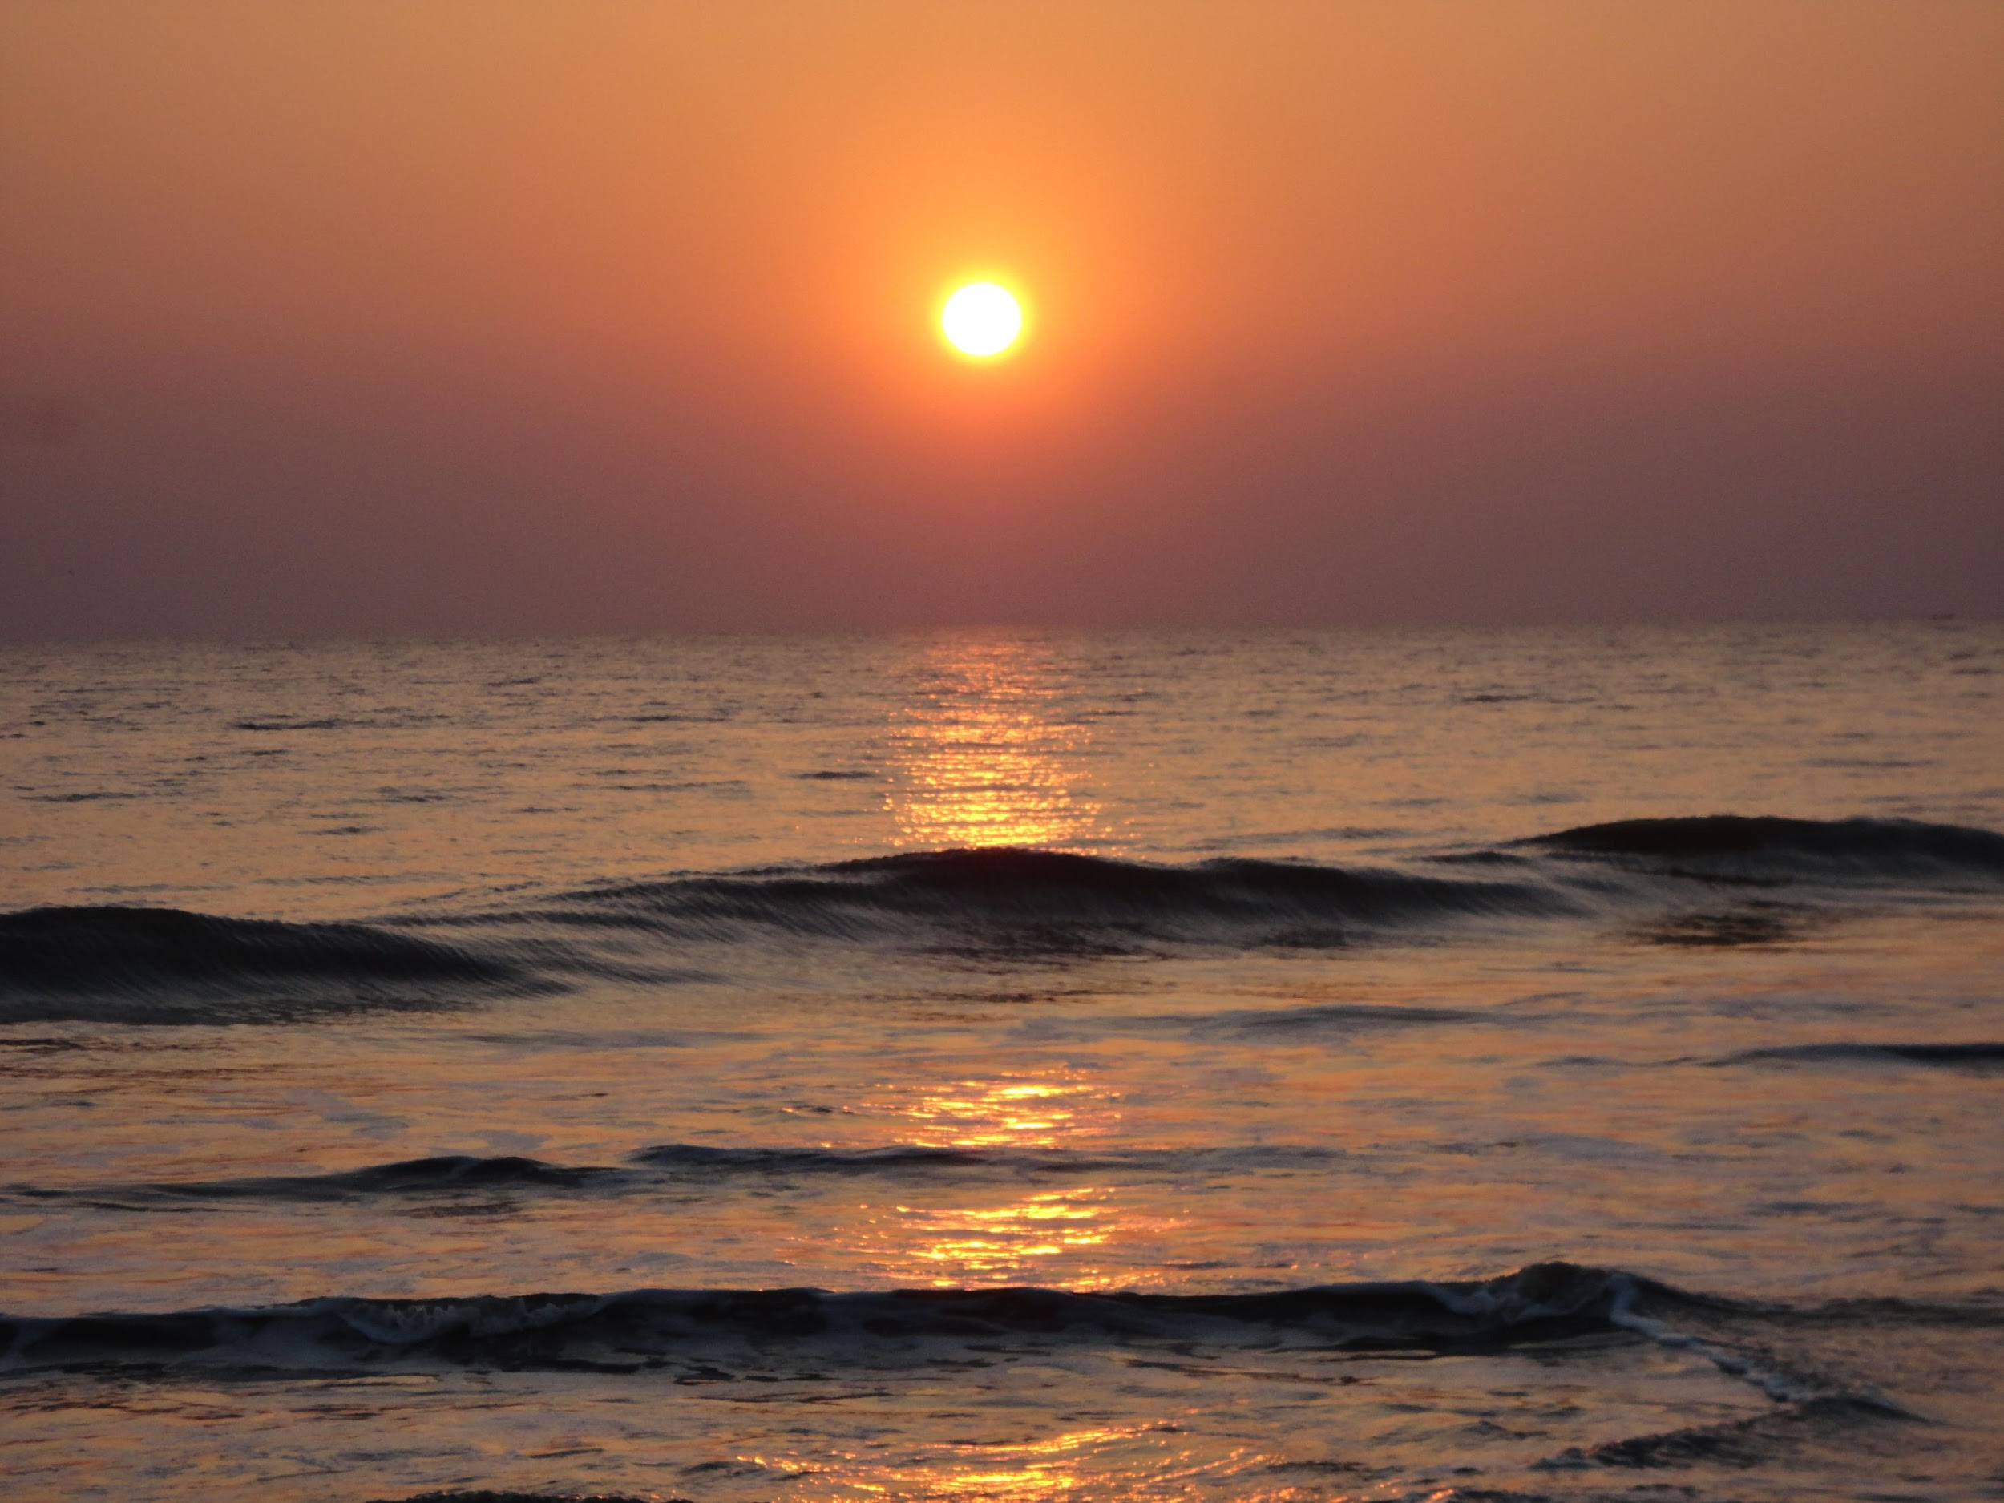
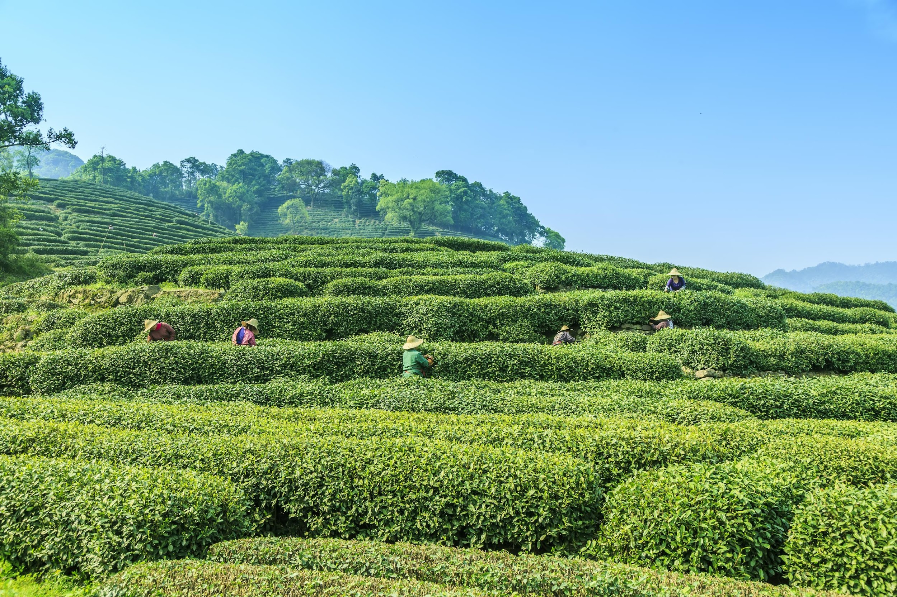
There are lot of scenic beauty herein Bangladesh.
Let’s have a brief look.
Bil
Sajek Vally
Hill Tracts
Cox’s Bazar
Tiger
Gutia Mosque
St. Martin’s Island
Kuakata
Tea Garden

Slide 3
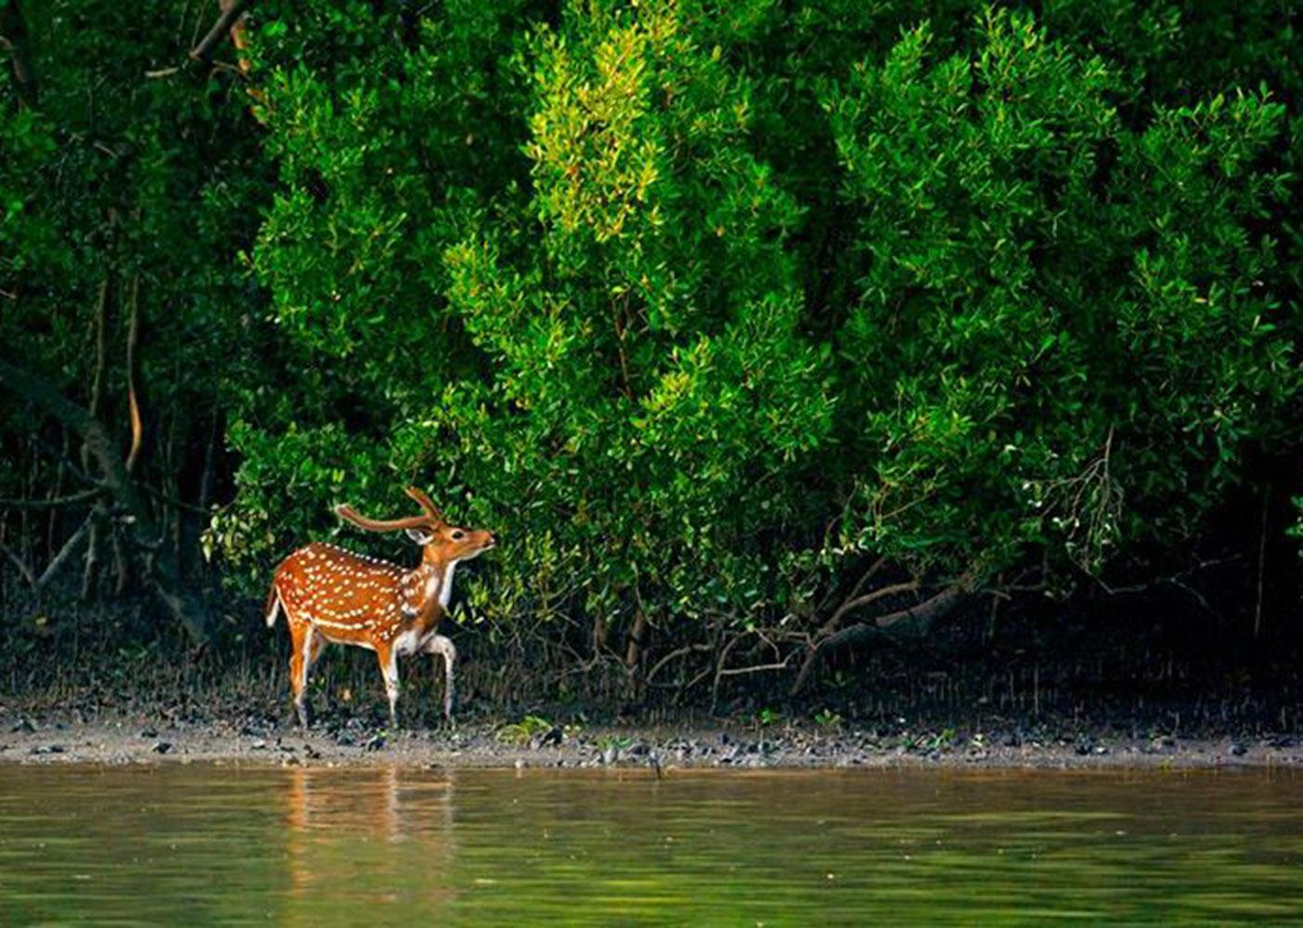
1. Sundarbans: Beautiful Bangladesh
There is a mangrove forest, i. e. Sundarbans, located in the southern part of Bangladesh and it is the only economical means of five districts, i. e. Satkhira, Khulna, Bagerhat, Patuakhali, Barguna.
It is declared as ecological critical area by the Government of Bangladesh under the Bangladesh Environment Conservation Act, 1995

Slide 4
1.1. Sundarbans: Beautiful Bangladesh
There are lot of species in the area of Sundarbans, i. e. the Royal Bengal Tigers, Deers, Bears, crabs, Snackes, Crocodiles etc., which are the soul of the mangrove forest.
Economically it bears a significant importance since it provides the 25% of GDP herein Bangladesh. Besides, the people of this region leads their lives by catching crab, fish and collecting honey etc. from this forest and often they out and out sacrificed their life in order to look after lives.

Slide 5
2. Cox’s Bazar: Beautiful Bangladesh
This the world’s largest sea beach and an ecologically critically area declared by the Government of Bangladesh under the BECA,1995.
It is located at Cox’s Bazar District at Chattogram region in Bangladesh and it is the epicenter of recreation of millions of people of the land.

Slide 6
3. Epicenter of Clouds and Hills: Beautiful Bangladesh
The lands of Hill Tracts of Bangladesh are blessed with the lovely mountains and clouds and the people of this land often visit this areas to furnish their cherished dreams.

Slide 7
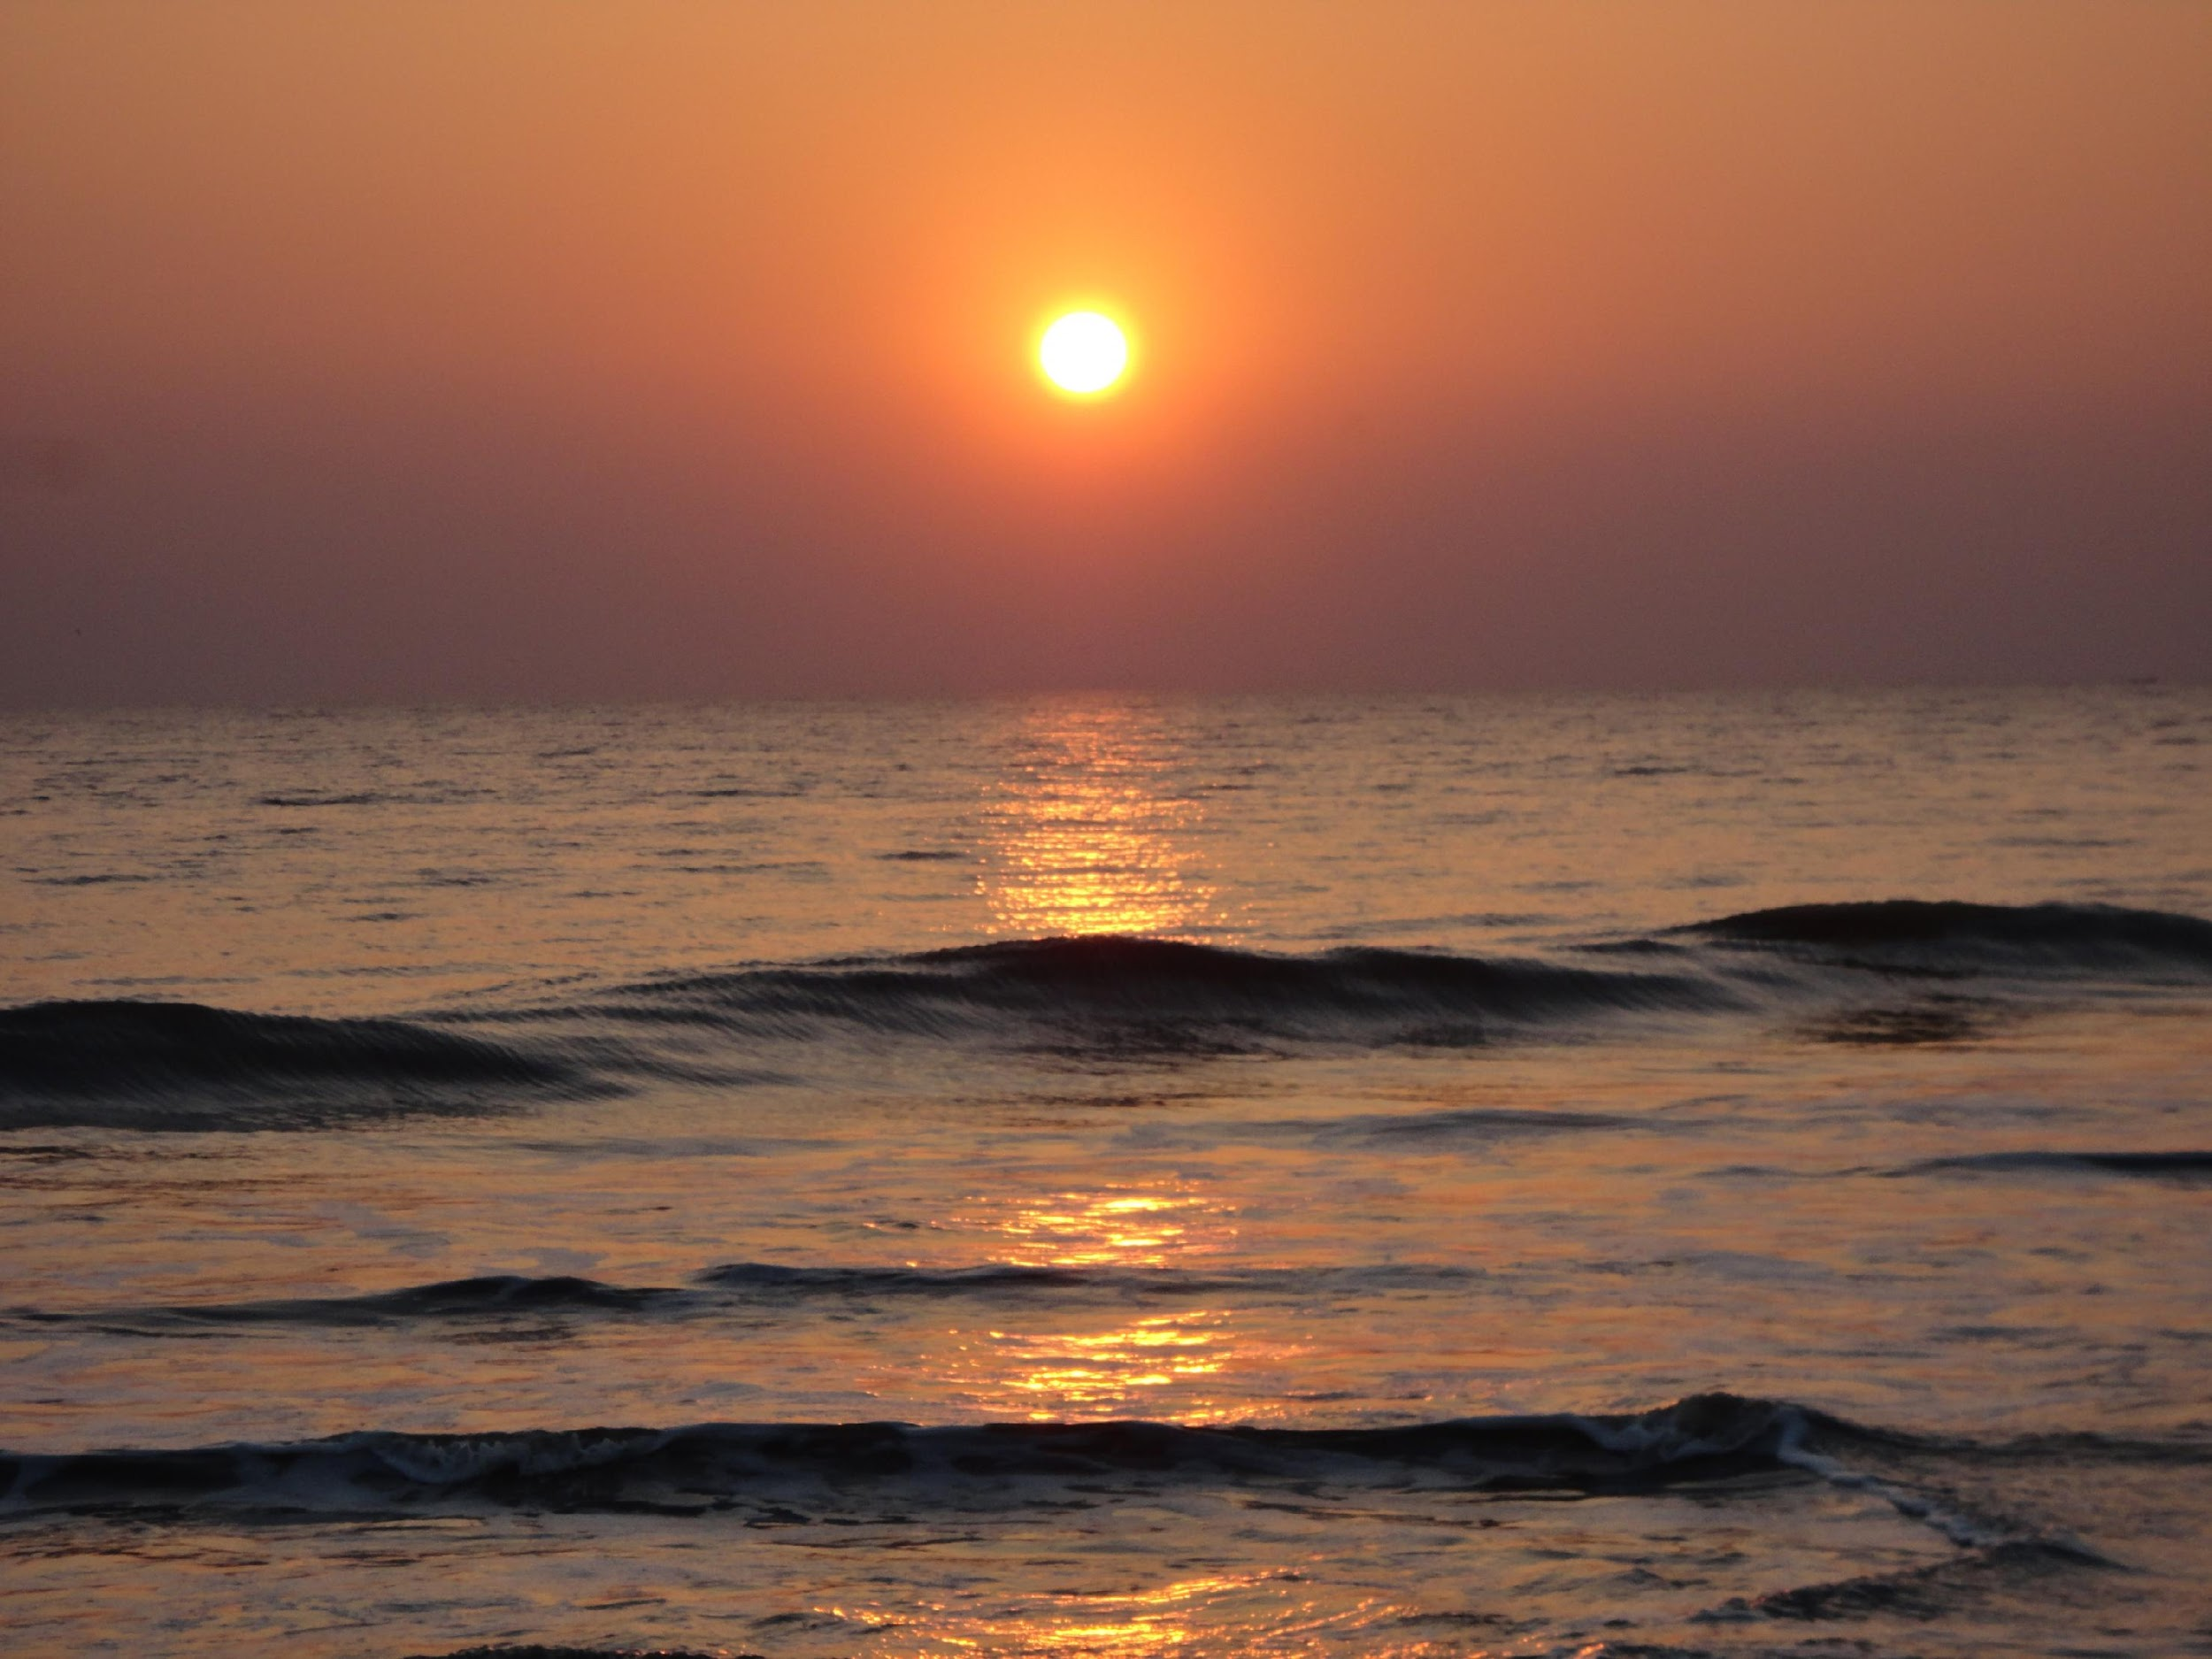
4. Kuakata Sea Beach: Daughter of the Sea
Kuakata Sea Beach is located at Kalapara upazila at Patuakhali District at Barishal Region in Bangladesh.
It is only the place from where the people of this land can mitigate their cherished thirst.

Slide 8
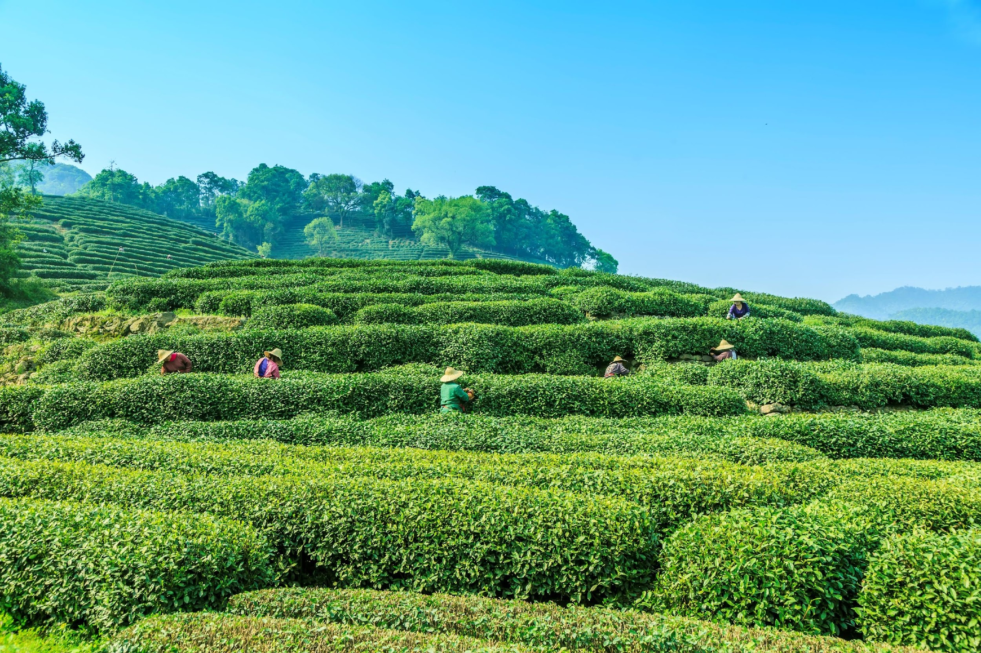
4. Tea Garden: Beauty of Hills
There are lot of tea gardens at Sylhet region in Bangladesh and the derelict tea gardens cannot be mortgaged since it is owned by the Government.
Tea Gardens produce tea and strengthen the country’s GDP. Besides, it fulfil the thirst of the people of the country by its own beauty.

Slide 9
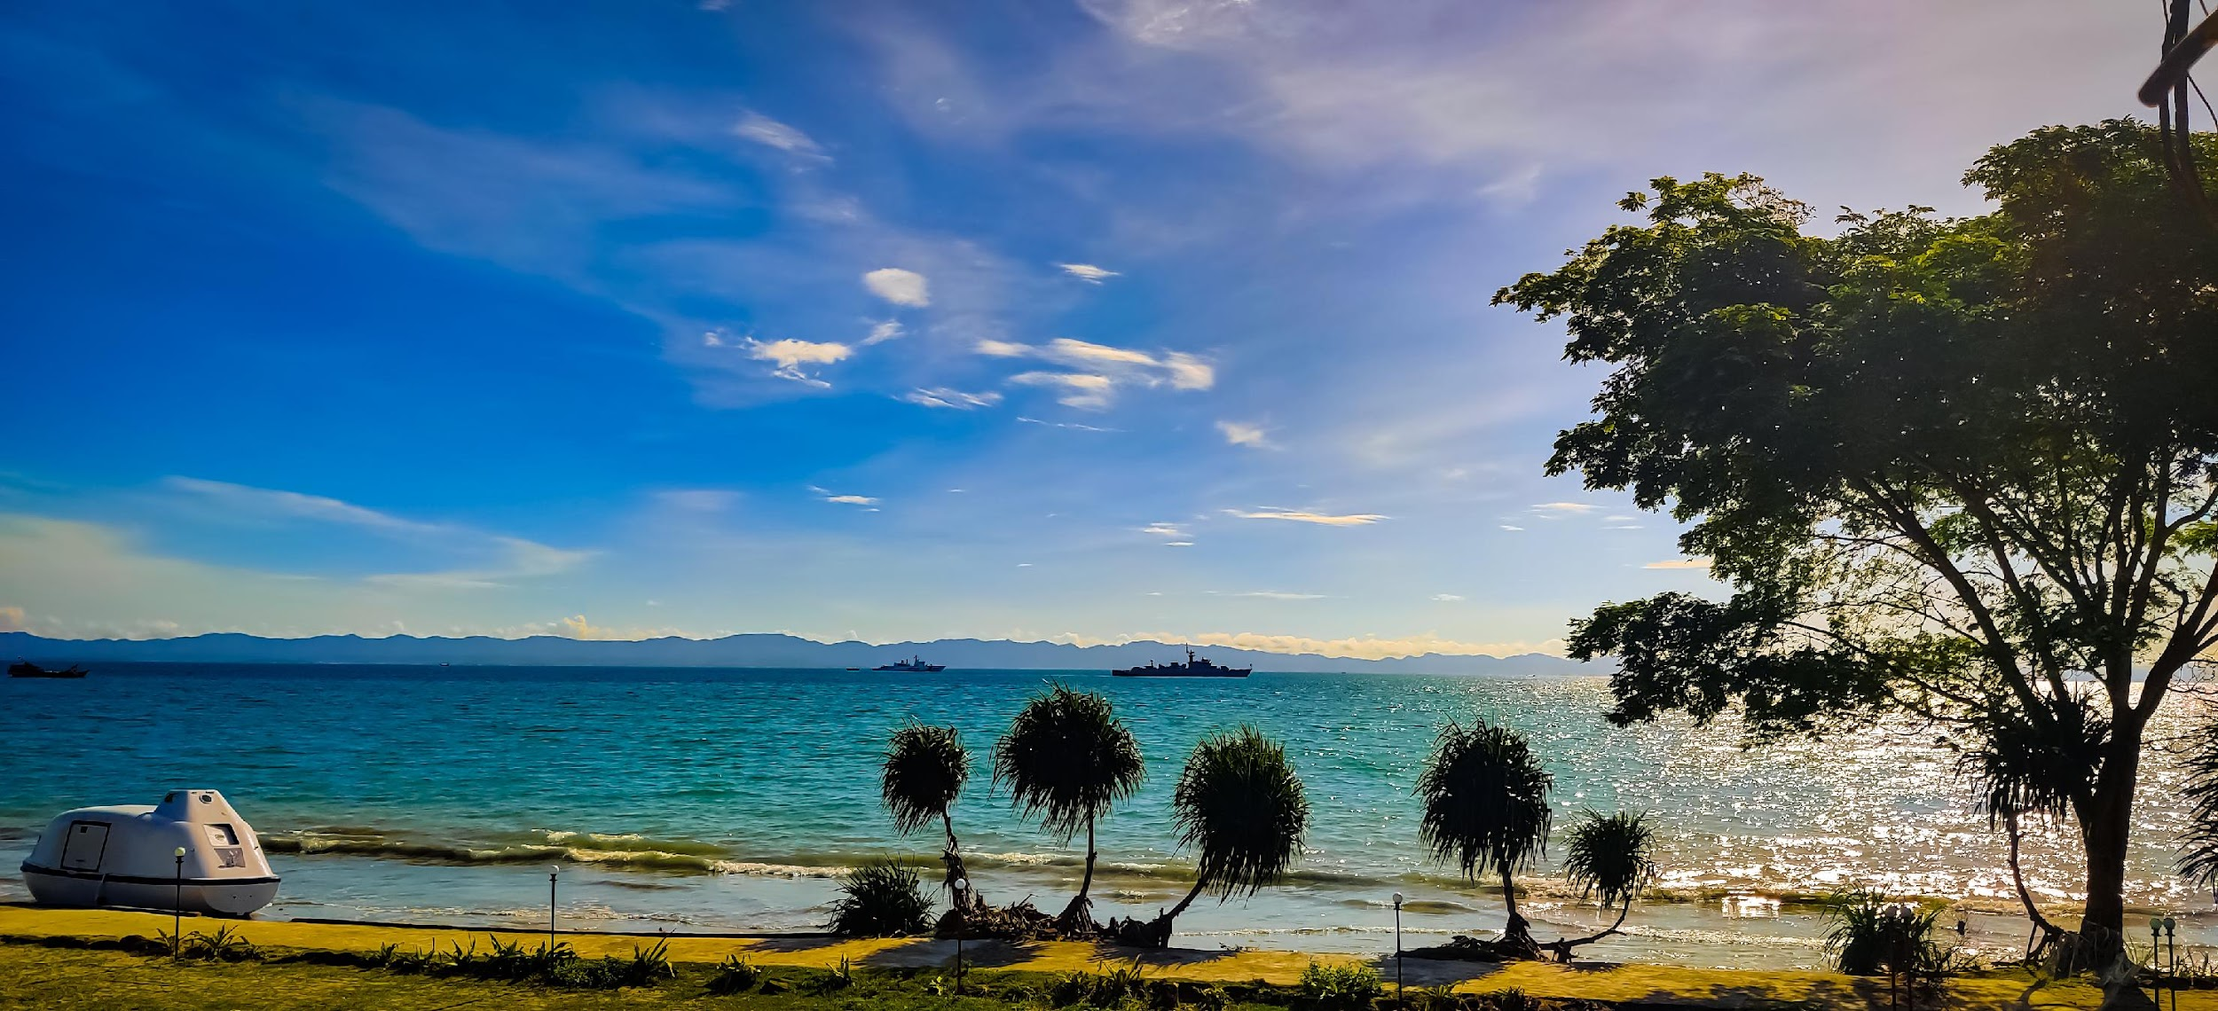
5. Saint Martin’s Island: Beautiful Bangladesh
Saint Martin Island is one of the scenic beautiful places herein Bangladesh which is an ecological critical area declared under the BECA,1995 by the Government of Bangladesh.
Many people often visit to this island by means of Ships or speed boat and enjoy the natural beauty of this island.

Slide 10


